Slide 1



Slide 2



Welcome
Email
Password
Sign in
You don’t have any accounts? Create one!
Eng – Viet Dictionary

Slide 3


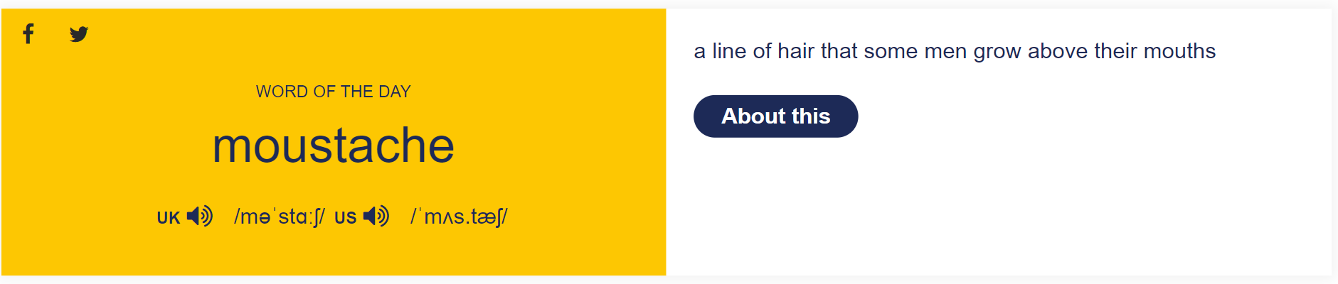


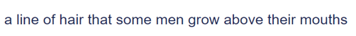
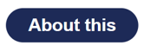
English – Vietnamese Learner’s Dictionary
Username
Search
nếu click vào x thì sẽ nhảy vào phần tra từ điển (như slide dưới)
nếu click vào about this thì sẽ tra từ này và hiện nó ra ở scene như slide dưới

Slide 4
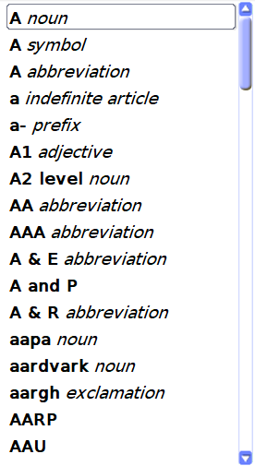

English – Vietnamese Learner’s Dictionary
Username
Search words
Index
Search something

Slide 5
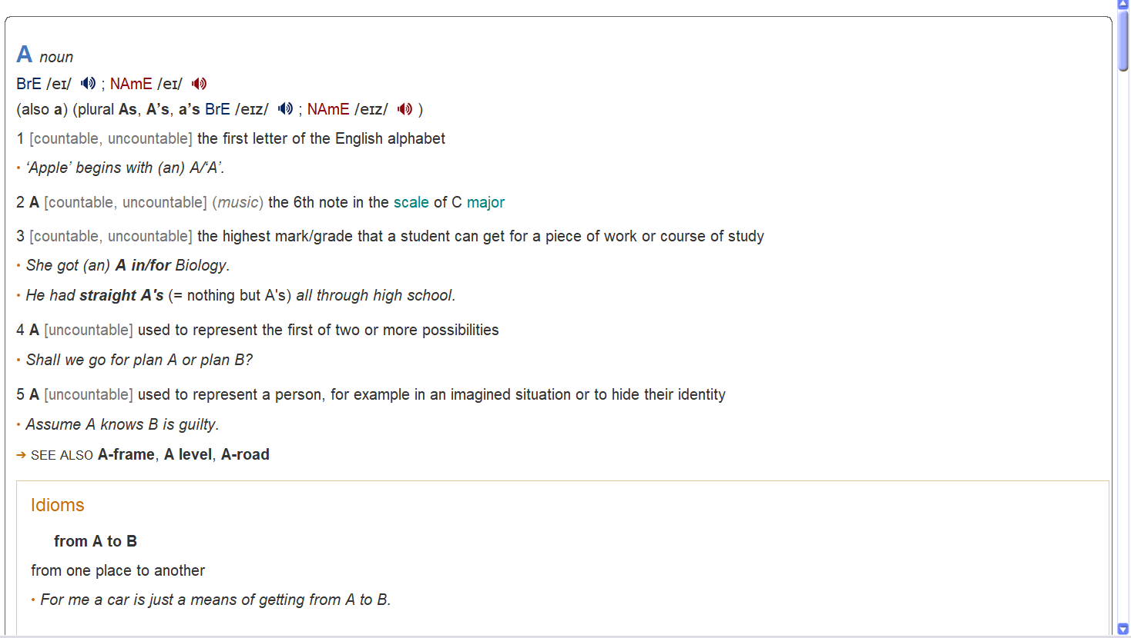

English – Vietnamese Learner’s Dictionary
Username
A
Index

Slide 6
English – Vietnamese Learner’s Dictionary
Username
A
Index
Edit options
Redefinition
Delete

Slide 7
English – Vietnamese Learner’s Dictionary
Username
Redefinition words
A
Index
A
Edit options
Parts of speech
noun
Redefinition
Delete
BrE IPA
/ei/
NAmE IPA
/ei/
Meaning
Discard changes
Save

Slide 8
English – Vietnamese Learner’s Dictionary
Username
Search
Welcome Username!
Index
Sign out

Slide 9








MENU
English – Vietnamese Learner’s Dictionary
Username
A
Home
Index
Index
Saved word
Translate Online
Add new words
Game
Settings
Information

Slide 10
English – Vietnamese Learner’s Dictionary
Username
MENU
Search
Home
Index
Saved word
Translate Online
Add new words
Game
Settings
Information

Slide 11
English – Vietnamese Learner’s Dictionary
Username
MENU
Search
Home
Index
Saved word
Translate Online
Add new words
Game
Settings
Information

Slide 12
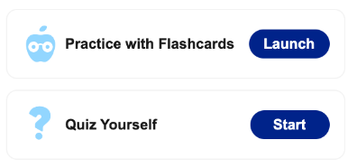
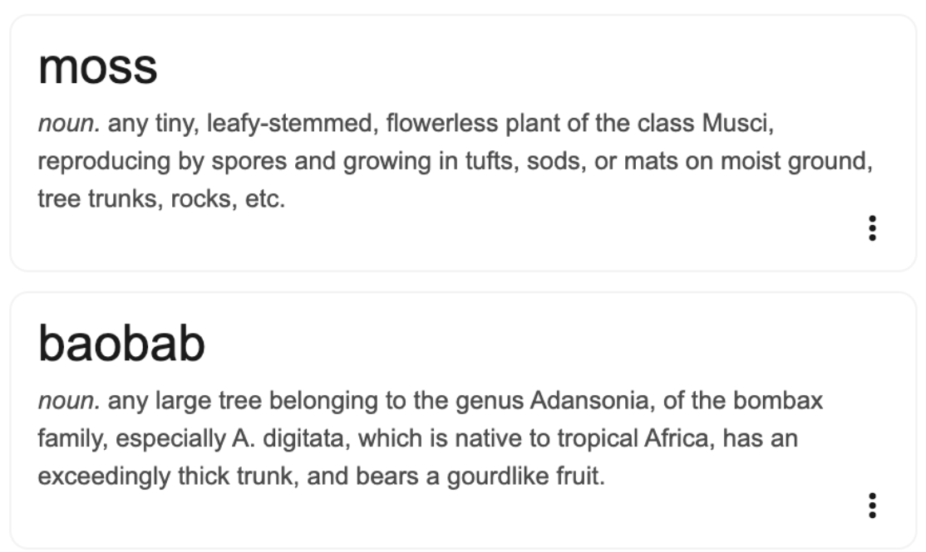
English – Vietnamese Learner’s Dictionary
Username
Saved Words
Search saved words

Slide 13
English – Vietnamese Learner’s Dictionary
Username
MENU
Search
Home
Index
Saved word
Translate Online
Add new words
Game
Settings
Information

Slide 14
English – Vietnamese Learner’s Dictionary
Username
MENU
Search
Home
Index
Saved word
Translate Online
Add new words
Game
Settings
Information

Slide 15

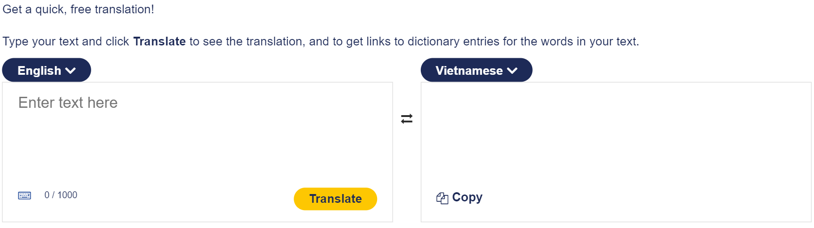


English – Vietnamese Learner’s Dictionary
Username
Online Translator

Slide 16
English – Vietnamese Learner’s Dictionary
Username
MENU
Search
Home
Index
Saved word
Translate Online
Add new words
Game
Settings
Information

Slide 17
English – Vietnamese Learner’s Dictionary
Username
MENU
Search
Home
Index
Saved word
Translate Online
Add new words
Game
Settings
Information

Slide 18
English – Vietnamese Learner’s Dictionary
Username
Add new words
Enter your word here
Parts of speech
Enter part of speech
BrE IPA
Enter BrE IPA
NAmE IPA
Enter NAmE IPA
Meaning
Enter meaning
Discard changes
Save

Slide 19

English – Vietnamese Learner’s Dictionary
Username
Add new words
Enter your word here
Parts of speech
Enter part of speech
BrE IPA
Enter BrE IPA
NAmE IPA
Enter NAmE IPA
Meaning
Enter meaning
Discard changes
Save

Slide 20
English – Vietnamese Learner’s Dictionary
Username
Add new words
Enter your word here
Parts of speech
Enter part of speech
Notification
Email
Username
Password
BrE IPA
Enter BrE IPA
Your new word is added successfully!
NAmE IPA
Enter NAmE IPA
Meaning
Enter meaning
Okay
Discard changes
Save

Slide 21
English – Vietnamese Learner’s Dictionary
Username
Add new words
Enter your word here
Alert
Parts of speech
Enter part of speech
Email
Username
Password
The word to be added has already existed. Do you want to update or append? Once you update the word, the old data will be replaced with the new one.
BrE IPA
Enter BrE IPA
NAmE IPA
Enter NAmE IPA
Meaning
Enter meaning
I want to update the word
Just append it
Discard changes
Save

Slide 22
English – Vietnamese Learner’s Dictionary
Username
Add new words
Enter your word here
Parts of speech
Enter part of speech
Notification
Email
Username
Password
BrE IPA
Enter BrE IPA
The word is update successfully!
NAmE IPA
Enter NAmE IPA
Meaning
Enter meaning
Okay
Discard changes
Save

Slide 23
English – Vietnamese Learner’s Dictionary
Username
Add new words
Enter your word here
Parts of speech
Enter part of speech
Notification
Email
Username
Password
BrE IPA
Enter BrE IPA
New meaning is appended successfully!
NAmE IPA
Enter NAmE IPA
Meaning
Enter meaning
Okay
Discard changes
Save

Slide 24
English – Vietnamese Learner’s Dictionary
Username
MENU
Search
Home
Index
Saved word
Translate Online
Add new words
Game
Settings
Information

Slide 25
English – Vietnamese Learner’s Dictionary
Username
MENU
Search
Home
Index
Saved word
Translate Online
Add new words
Game
Settings
Information

Slide 26





English – Vietnamese Learner’s Dictionary
Username
Game
Advanced your vocabulary with our games and quizzes.
Flashcard
Launch
Studying
Launch
Challenging
Launch
Matching
Launch

Slide 27

Flashcards
[WORD]
Notes:
background color: #FFB097
title rectangle color: #FFC000
word color: #951D05

Slide 28
Flashcards
[IPA]
[Detail]
Notes:
background color: #FFB097
detail color: #12225B
ipa color: #000000

Slide 29




Studying
choice A
[Word]
choice B
choice C
Notes:
background color: #F0F0F0

Slide 30


Studying
choice A
[Word]
choice B
choice C
Well done!
Next
Notes:
background color: #F0F0F0
word color: #12225B
right choice color: #C5E0B4
right choice font color: #385723
next button color: #12225B

Slide 31
Studying
choice A
[Word]
choice B
choice C
Don’t worry, just keep learning!
Next
Notes:
background color: #F0F0F0
word color: #12225B
right choice color: #C5E0B4
right choice font color: #385723
wrong choice color: #FFB097
wrong choice font color: #C00000
next button color: #12225B

Slide 32
Challenging
choice A
You will have a set of 20 questions with given Vietnamese meaning and 5 seconds to choose the most suitable English lexis.
Every correct answer you will get 10 points.
However, be careful as you also lose 5 points for each incorrect choice.
Try your best and get the as high score as you can!
[Word]
choice B
choice C
Start
Notes:
background color: #F0F0F0

Slide 33
Challenging
Score:
choice A
[Word]
choice B
choice C
Notes:
background color: #F0F0F0

Slide 34
Challenging
Score:
choice A
[Word]
choice B
choice C
Well done! + 10pt
Next
Notes:
background color: #F0F0F0
word color: #12225B
right choice color: #C5E0B4
right choice font color: #385723
next button color: #12225B

Slide 35
Challenging
Score:
choice A
[Word]
choice B
choice C
That’s incorrect! - 5pt
Next
Notes:
background color: #F0F0F0
word color: #12225B
right choice color: #C5E0B4
right choice font color: #385723
wrong choice color: #FFB097
wrong choice font color: #C00000
next button color: #12225B

Slide 36
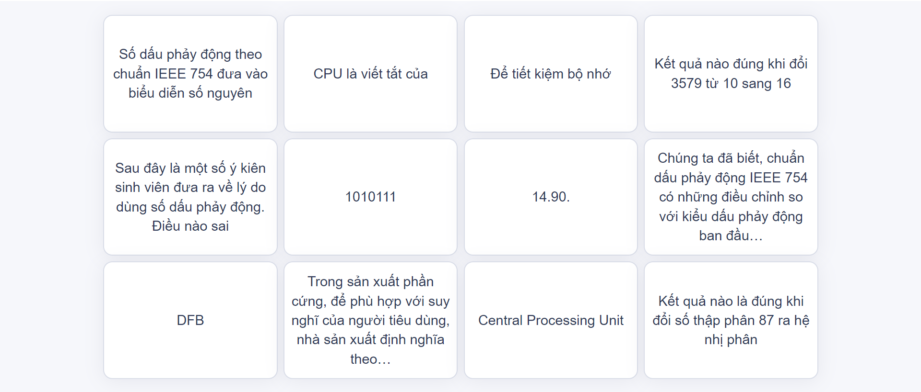
Matching
Ten words and their definitions will be shown in 20 boxes randomly.
Try to match all the terms with their definitions as quickly as possible. Avoid incorrect matches. They add extra time!
[Word]
choice B
Start
Notes:
background color: #F0F0F0

Slide 38
English – Vietnamese Learner’s Dictionary
Username
MENU
Search
Home
Index
Saved word
Translate Online
Add new words
Game
Settings
Information

Slide 39
English – Vietnamese Learner’s Dictionary
Username
Settings
User settings
Text size
⃝ Small
⃝ Medium
⃝ Large
⃝ Very Large
Application settings
Text size
Automatic Sound
Theme
User settings
Change password
Delete account

Slide 40
English – Vietnamese Learner’s Dictionary
Username
Settings
User settings
Automatic Sound
⃝ Man
⃝ Woman
Application settings
Text size
Automatic Sound
Theme
User settings
Change password
Delete account

Slide 41
English – Vietnamese Learner’s Dictionary
Username
Settings
User settings
Theme
⃝ Light
⃝ Dark
Application settings
Text size
Automatic Sound
Theme
User settings
Change password
Delete account

Slide 42
English – Vietnamese Learner’s Dictionary
Username
Settings
User settings
Change password
Application settings
Current password
New password
Confirm new password
Text size
Automatic Sound
Theme
User settings
Change password
Delete account
Change

Slide 43
English – Vietnamese Learner’s Dictionary
Username
Settings
User settings
Change password
Application settings
Notification
Current password
New password
Confirm new password
Text size
Automatic Sound
Your password is updated successfully!
Theme
Okay
User settings
Change password
Delete account
Change

Slide 44
English – Vietnamese Learner’s Dictionary
Username
Settings
User settings
Delete account
Please enter your account information to continue:
Application settings
Email
Username
Password
Text size
Automatic Sound
Theme
User settings
Change password
Delete account
Next

Slide 45
English – Vietnamese Learner’s Dictionary
Username
Settings
User settings
Delete account
Please enter your account information to continue:
Warning
Application settings
Email
Username
Password
Text size
Automatic Sound
Once you confirm delete your account, all of your data will be lost. Do you want to continue?
Theme
User settings
Back
Confirm
Change password
Delete account
Next

Slide 46
English – Vietnamese Learner’s Dictionary
Username
Settings
User settings
Delete account
Please enter your account information to continue:
Application settings
Notification
Email
Username
Password
Text size
Automatic Sound
Your account is deleted successfully!
Theme
Okay
User settings
Change password
Delete account
Next

Slide 47
Welcome
Email
Password
Sign in
You don’t have any accounts? Create one!
Eng – Viet Dictionary

